Slide 1
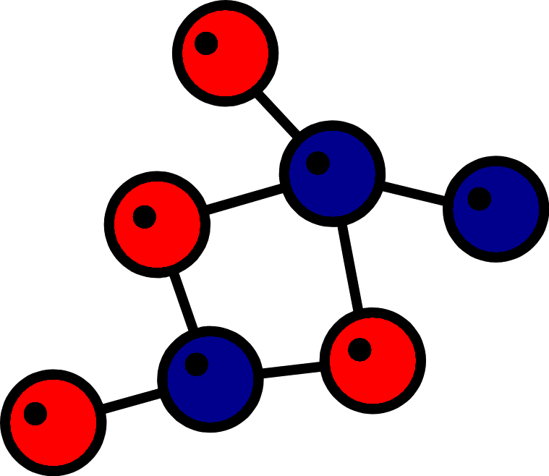
Chemical Bonding

Slide 2
Chemical Bond
A chemical bond is the physical phenomenon of chemical substances being held together by attraction of atoms to each other through sharing, as well as exchanging, of electrons -or electrostatic forces.
Chemical bonding is the only by which atoms achieve octet or doublet configuration.

Slide 3
Types of Chemical Bond
There are three major types of chemical bond-
Ionic Bond
  transfer of e⁻
Covalent Bond
  sharing e⁻
Metallic Bond
  Occurs among atoms of a metal
  Valence e⁻ are mobile

Slide 4
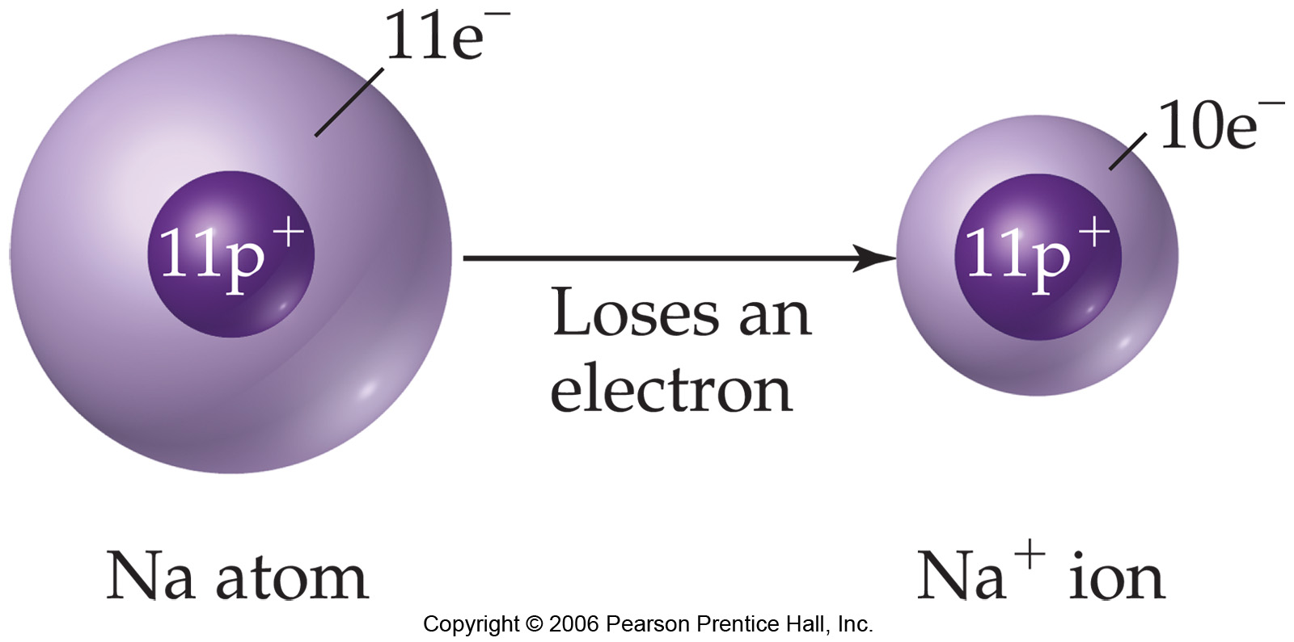
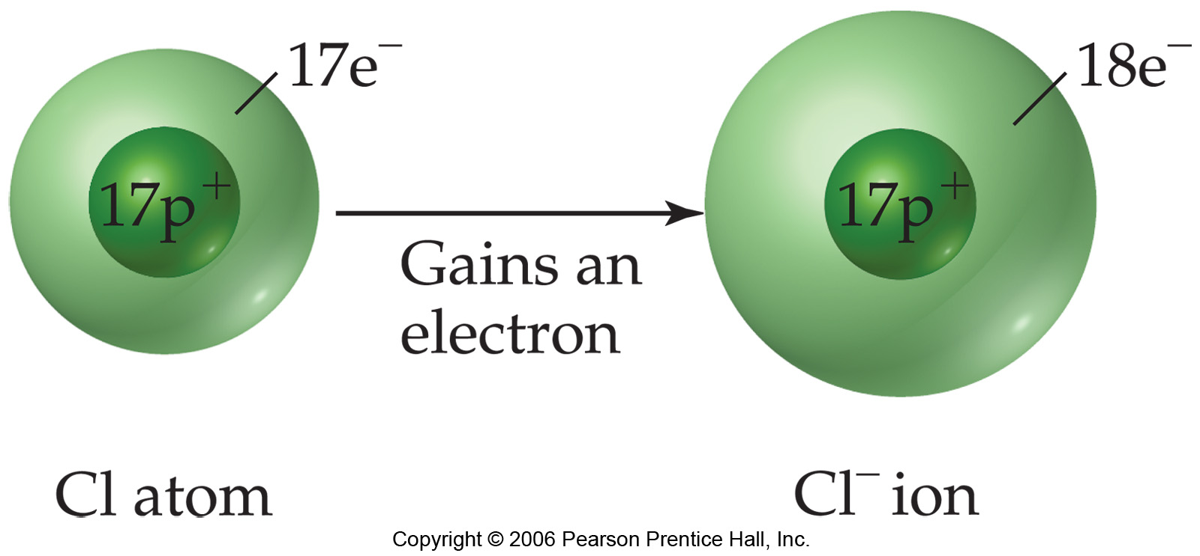
Ionic Bond
Ionic bonding is the electrostatic attraction between oppositely charged ions

Slide 5
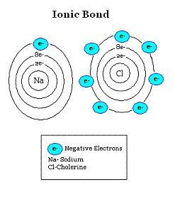
Ionic Bond

Slide 6
Ionic Bond
Electrons are transferred between valence shells of atoms
Ionic compounds are made of ions
Ionic compounds are called Salts or Crystals
Always formed between metals and non-metals
Electronegativity difference > 2.0
Lost e⁻
Gained e⁻

Slide 7
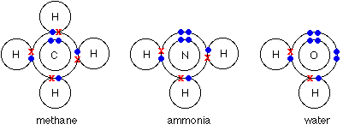
Covalent Bond
A covalent bond involves the sharing of electron pairs between atoms. These electron pairs are known as shared pairs or bonding pairs

Slide 8
Covalent Bond
Pairs of e⁻ are shared between non-metal atoms
Electronegativity difference < 2.0
Forms polyatomic ions
Low melting point and boiling point
Relatively soft solids as compared to ionic compounds
Nonconductors of electricity in any phase

Slide 9
Types of Covalent Bond
Nonpolar bond
  Electrons shared evenly in the bond
  Electronegativity difference is zero
  Example: Cl₂, O₂, H₂ etc.
Polar Bond
  Electrons unevenly shared
  Electronegativity difference greater than zero but less than 2.0
  Example: HCl, H₂O, NH₃ etc.

Slide 10
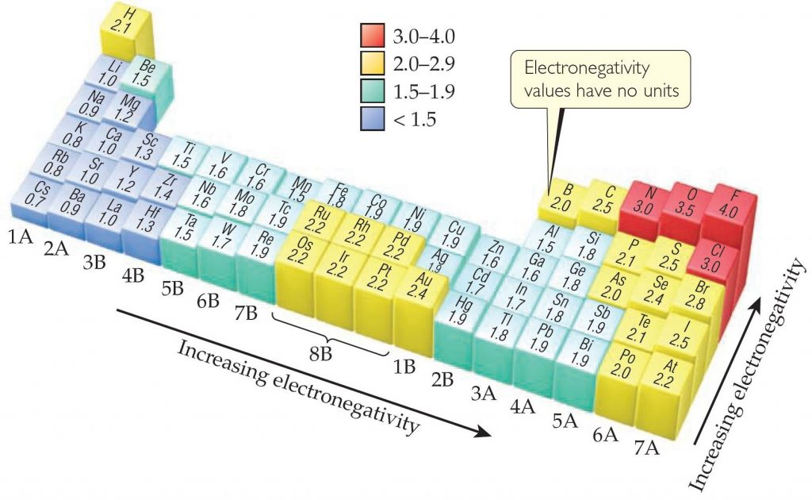
Electronegativity

Slide 11
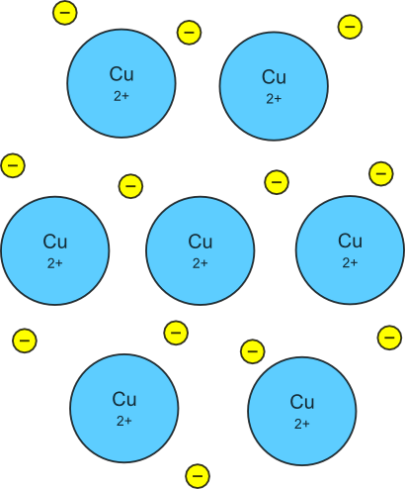
Metallic Bond
The chemical bonding that results from the attraction between metal cations and the surrounding sea of electrons
Vacant p and d orbitals in metal's outer energy levels overlap, and allow outer electrons to move freely throughout the metal
Valence electrons do not belong to any one atom

Slide 12
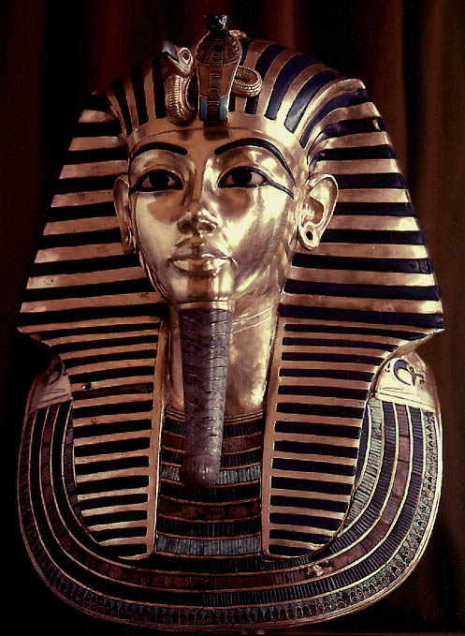
Metallic Bond
Metals are good conductors of heat and electricity
Metals are malleable
Metals are ductile
Metals have high tensile strength
Metals have luster

Slide 13
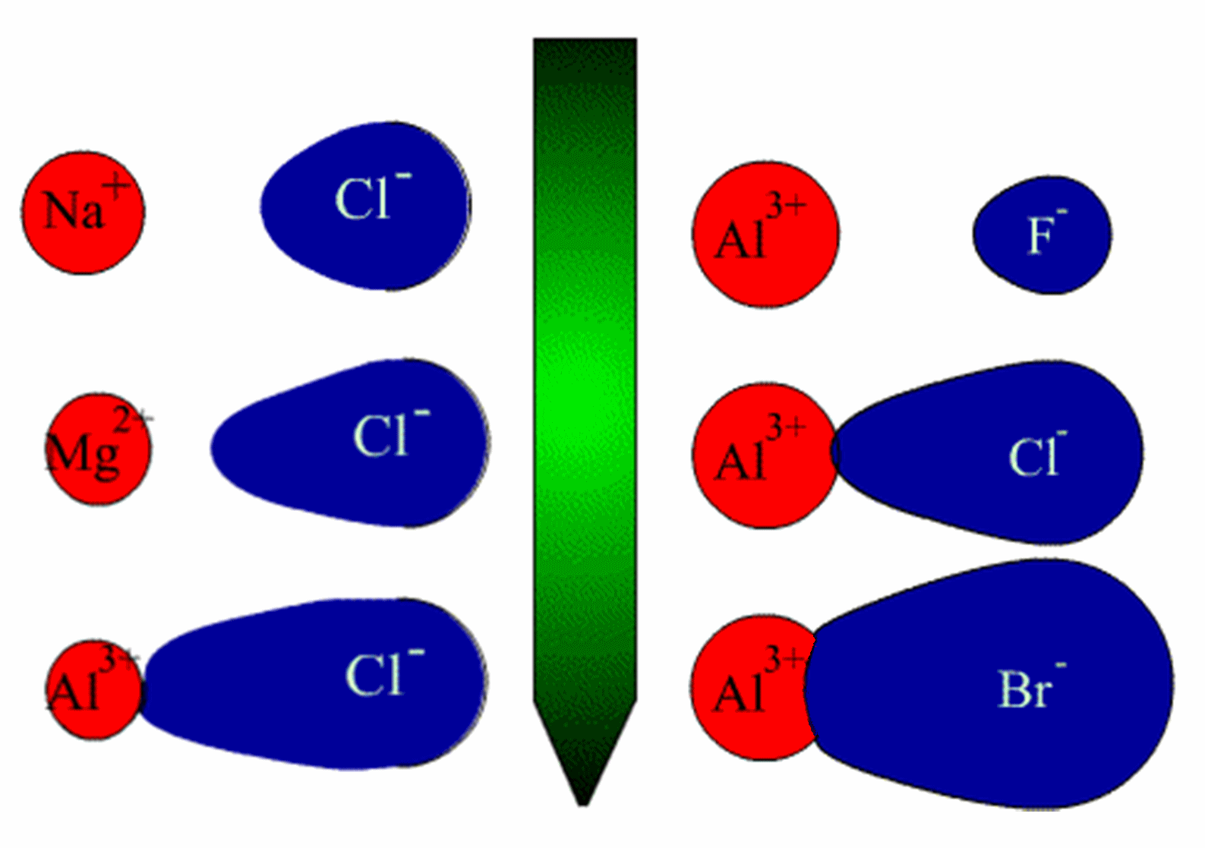
Polarization
If the cation is small and/or anion is large and/or they are highly charged, cation will distort the electron cloud of the anion, an effect summarized in Fajans' rules is called polarization.

Slide 14
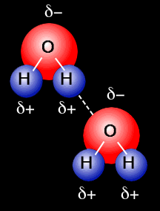
Hydrogen Bond
Occurs only between H of one molecule and N, O, F of another
Strong polar attraction
  Like magnets
H - bond

Slide 15
Van Der Waals Bond
Non-polar molecules can exist in liquid and solid phases because van der Waals forces keep the molecules attracted to each other
Exist between CO₂, CH₄, CCl₄, CF₄, diatomics and monoatomics
Increase with molecular mass
Increase with closer distance between molecules

Slide 16
THANK YOU FOR YOUR PATIENCE
HAVE A NICE DAY

